Slide 1

WELCOME TO OUR PRESENTATION
Course Code : CSE-2324
Course Title : Digital Logic Design Lab

Slide 2
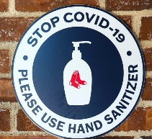


GRoUP PROJECT ON:
Smart Hand Sanitizer using TinkerCAD

Slide 3
Project done by:
Md. Anamul Haque
Matric ID: C211001
Section:3AM
Hossain Mohammad Meraj
Matric ID: C211002
Section:3AM
Meharaz Hossain
Matric ID: C211019
Section:3AM

Slide 4
Project Supervised By:
Md. Ziaur Rahman
Lecturer
Dept. Of CSE

Slide 5

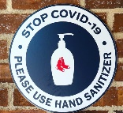

During the COVID-19 pandemic, keeping hands clean is especially important to help prevent the virus from spreading.
Most Of The Available Hand Sanitizers Do Not Operate Automatically.An Automatic Hand Sanitizer Which Will Operate On Its Own.

Slide 6
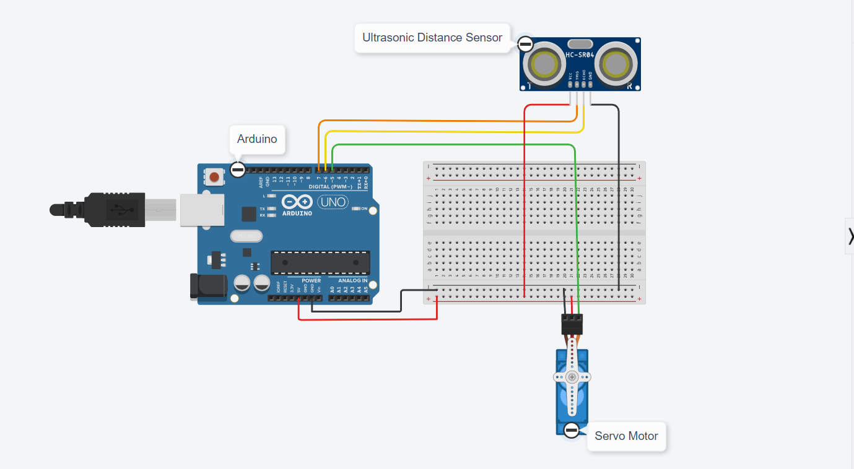
Circuit Diagram:
TinkerCAD Simulation Link: https://www.tinkercad.com/things/j0HApsYQ0br

Slide 7
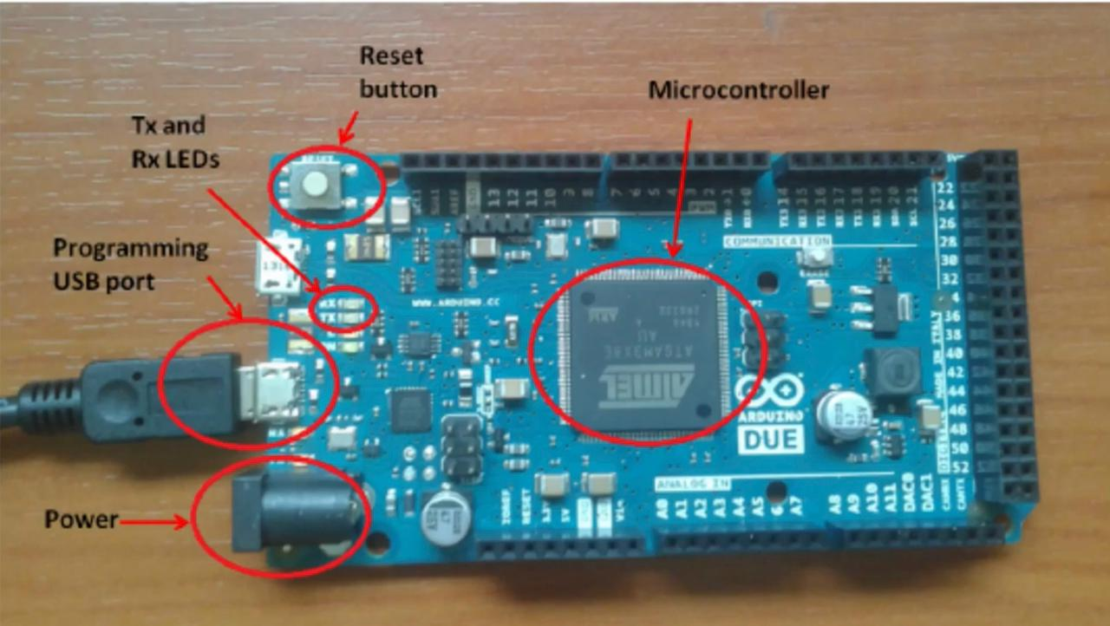
Components Of This Project:
Arduino Uno

Slide 8
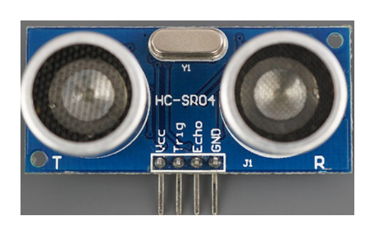
Components Of This Project:
Ultrasonic Sensor

Slide 9
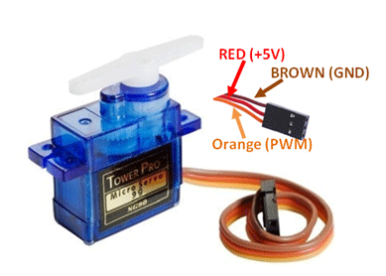
Components Of This Project:
Servo Motor

Slide 10

Components Of This Project:
Jumper Wire

Slide 11
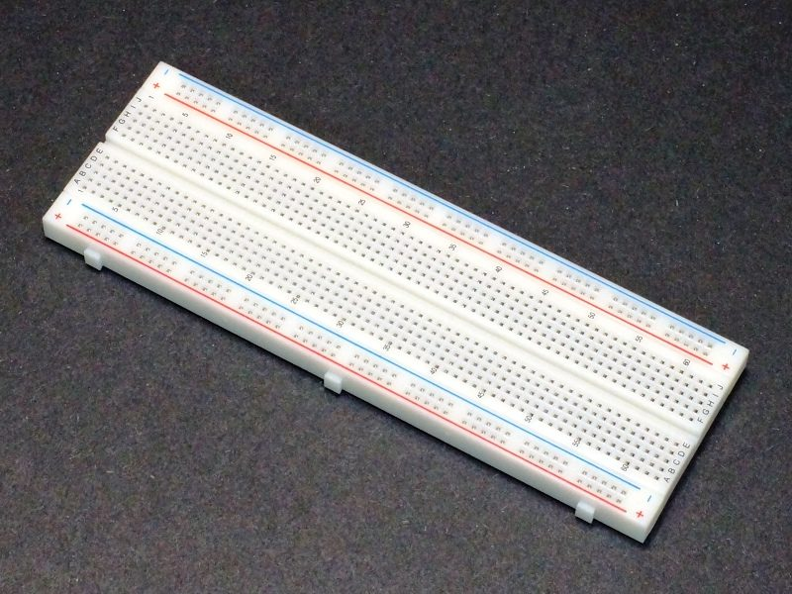
Components Of This Project:
BreadBoard

Slide 12
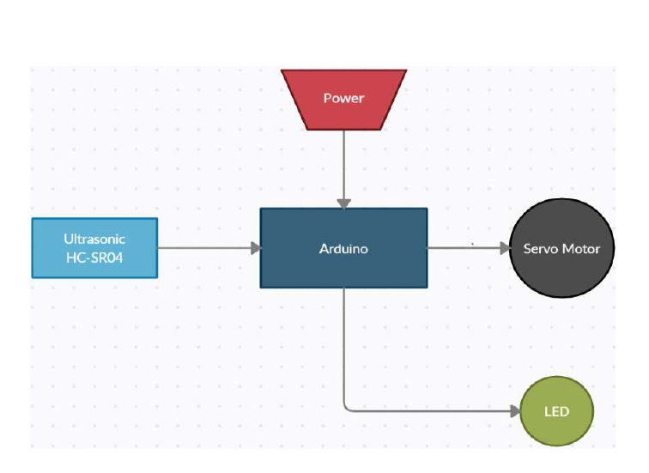
Block Diagram Of Project:
TinkerCAD Simulation Link: https://www.tinkercad.com/things/j0HApsYQ0br

Slide 13
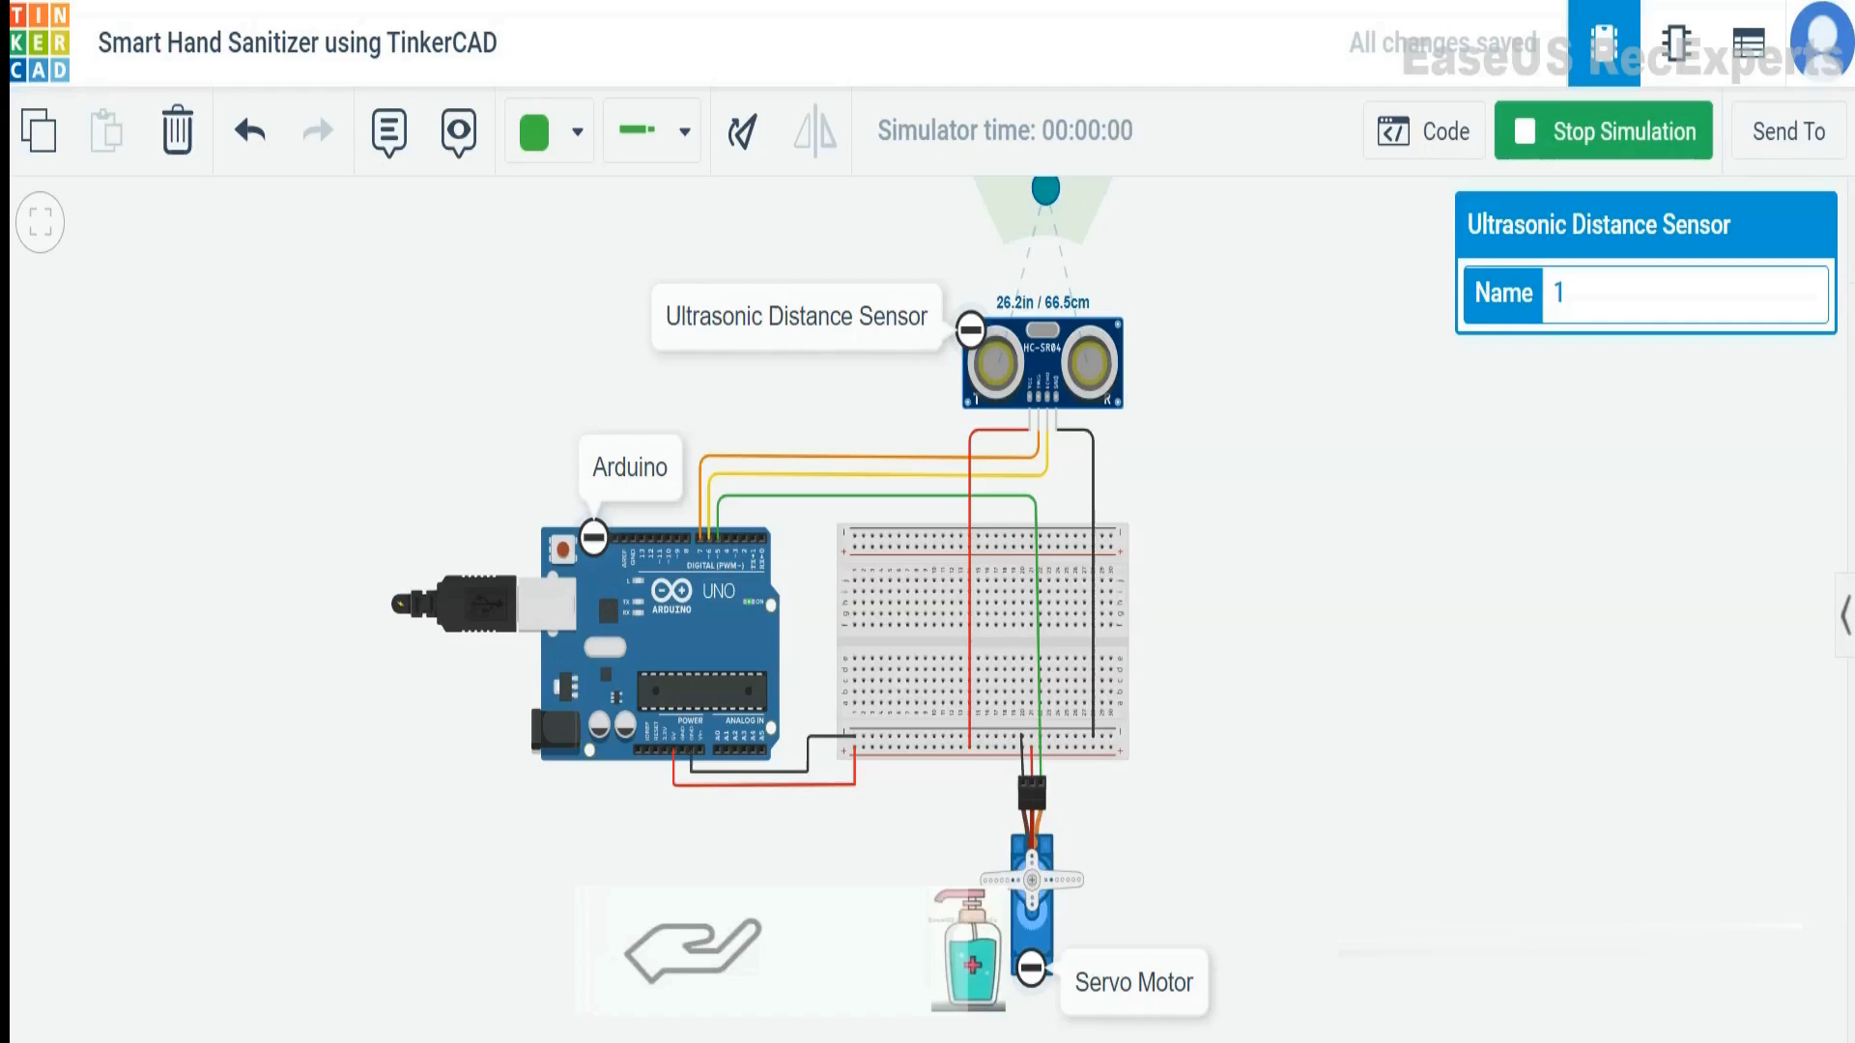
Working Of Project:
TinkerCAD Simulation Link: https://www.tinkercad.com/things/j0HApsYQ0br

Slide 14
Objective:
To contribute to contactless hand disinfection in public places and virus infection prevention.
It is economical and eco-friendly by decreasing waste emissions

Slide 15


